Slide 1
Chapter 15: Integer Optimization
Business Analytics: Methods, Models,
and Decisions, 1st edition
James R. Evans

Slide 2
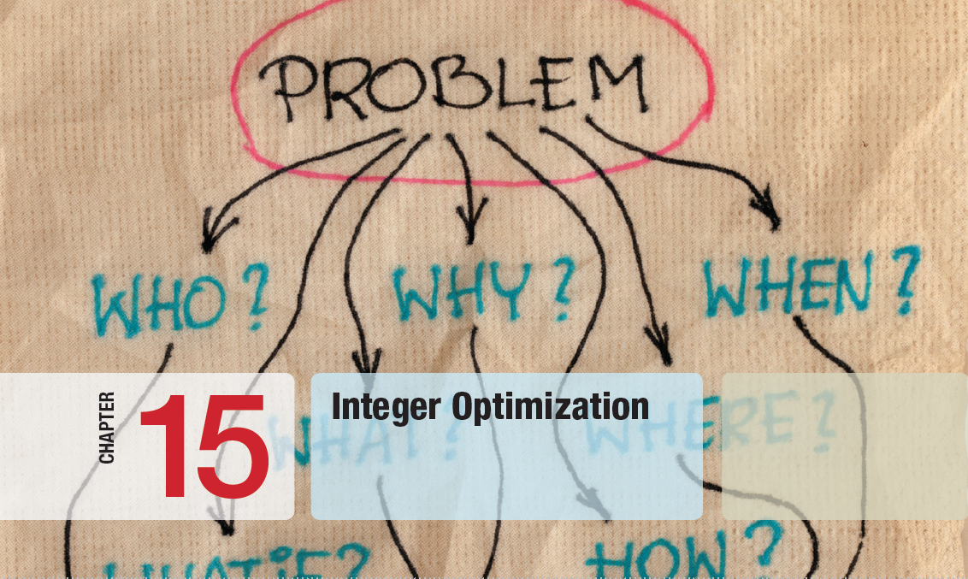

Slide 3
Chapter 15 Topics
Solving Models with General Integer Variables
Integer Optimization Models with Binary Variables
Mixed-Integer Optimization Models

Slide 4
Solving Models with General Integer Variables
Integer linear optimization models have some or all variables restricted to being whole numbers.
Decision variables that we force to be integers are called general integer variables.
Algorithms first solve the LP relaxation (no integer restrictions imposed) and gradually enforce integer restrictions using systematic searches.
Solver has a default integer tolerance of 0.05 so it will stop if it finds an integer solution within 5% of the optimal solution.

Slide 5
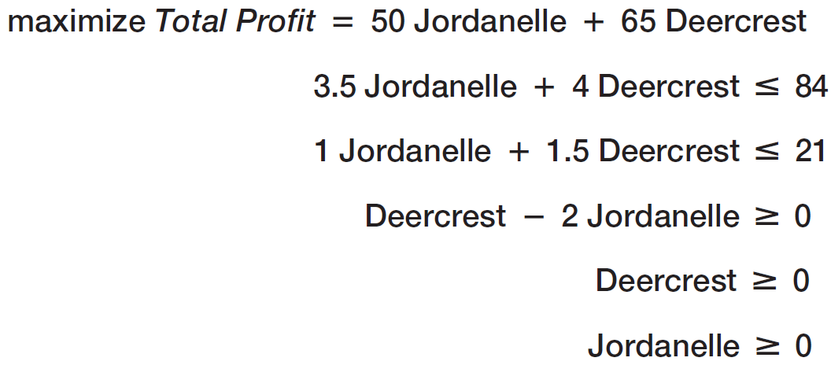
Solving Models with General Integer Variables
Example 15.1 Sklenka Skis Revisited
The optimal solution was to produce 5.25 pairs of Jordanelle skis and pairs of 10.5 Deercrest skis.
Suppose we want to enforce integer restrictions on the two decision variables.

Slide 6
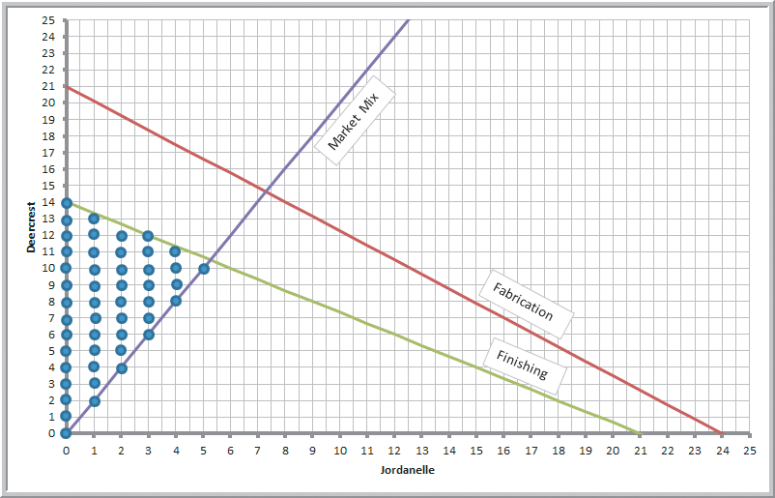
Solving Models with General Integer Variables
Example 15.1 (continued) Sklenka Skis Revisited
The feasible integer solutions are the dark blue dots on the graph.
Figure 15.1

Slide 7
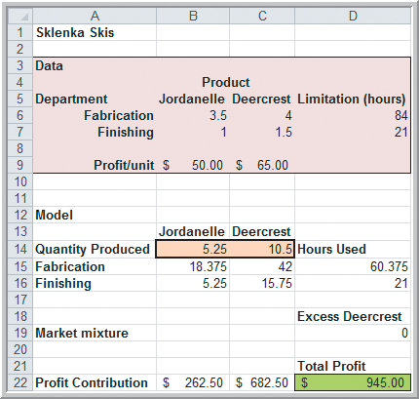
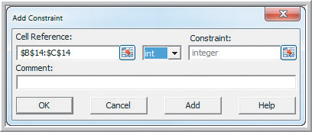
Solving Models with General Integer Variables
Example 15.1 (continued) Sklenka Skis Revisited
Add a constraint to the Solver model that restricts the decision variables to integer values.
Figure 15.2
When solving, choose Options and change the Integer Tolerance to 0.
Figure 13.5

Slide 8
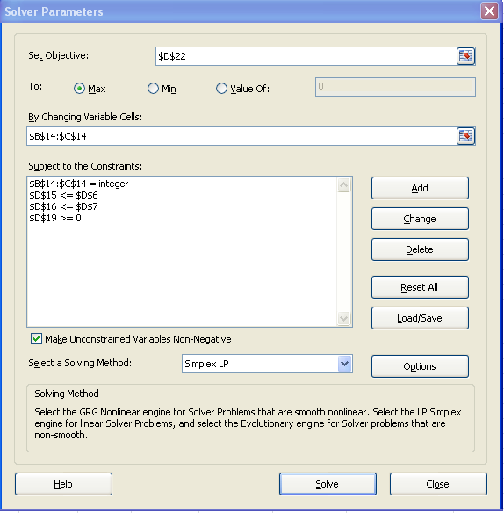
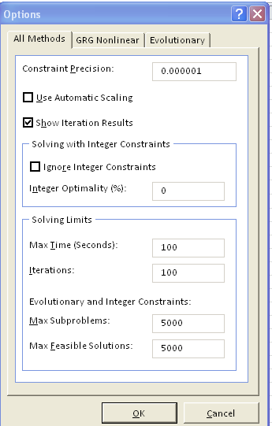
Solving Models with General Integer Variables
Example 15.1 (continued) Sklenka Skis Revisited

Slide 9
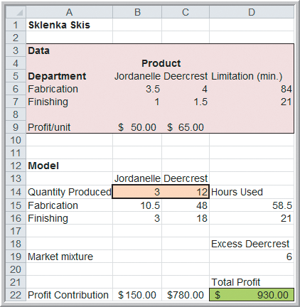
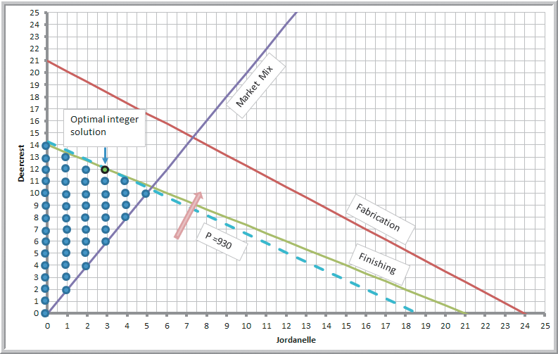
Solving Models with General Integer Variables
Example 15.1 (continued) Sklenka Skis Revisited
Figure 15.4
Compared with the non-integer LP, the optimal profit has decreased $15.
Figure 15.3

Slide 10
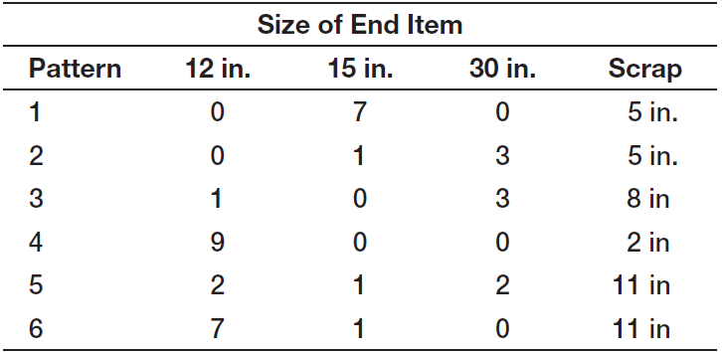
Solving Models with General Integer Variables
Example 15.2 A Cutting-Stock Problem
A company makes 110-inch wide rolls of thin sheet metal and slices them in smaller rolls of 12, 15, and 30 inches.
Six different cutting patterns are used.

Slide 11
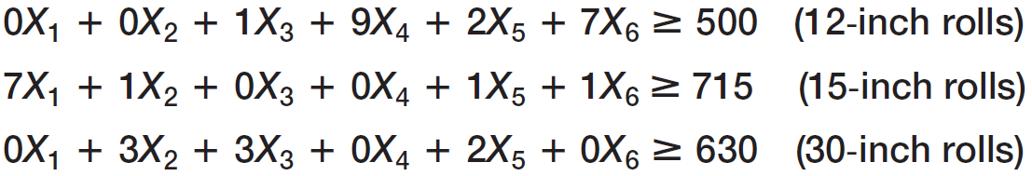
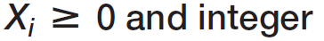
Solving Models with General Integer Variables
Example 15.2 (continued) A Cutting-Stock Problem
The objective is to minimize scrap metal.
The only constraints are end-item demand, nonnegativity, and integer restrictions.
X_{i} = number of 110-inch rolls to cut using pattern i

Slide 12
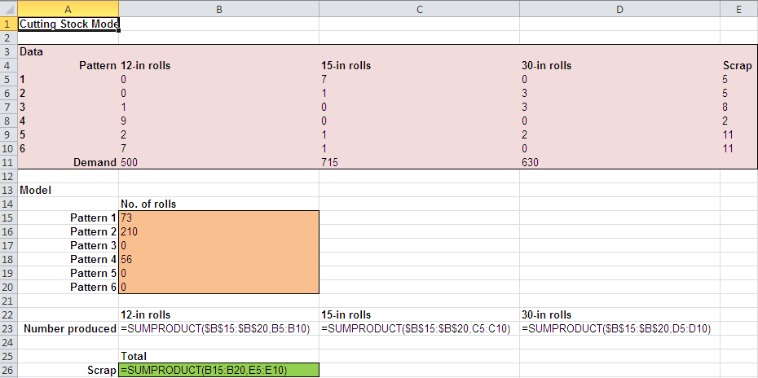
Solving Models with General Integer Variables
Example 15.2 (continued) A Cutting-Stock Problem
From Figure 15.5

Slide 13
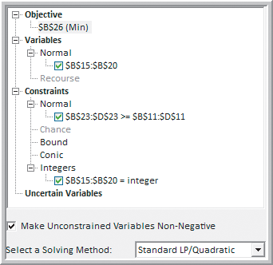
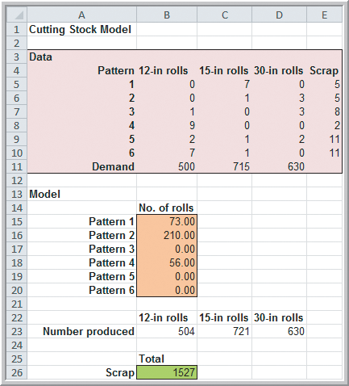
Solving Models with General Integer Variables
Example 15.2 (continued) A Cutting-Stock Problem
Figure 15.6
Figure 15.5

Slide 14
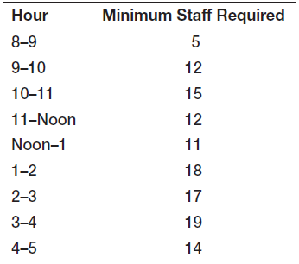
Solving Models with General Integer Variables
Example 15.3 Brewer Services
Workforce Scheduling Problem
Brewer Services schedules customer service workers on Monday to Friday, 8 a.m. to 5 p.m.
5 permanent employees work all day.
Part-time employees work 4-hour shifts.
How many part-time employees
are needed to meet staffing
requirements?

Slide 15
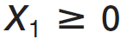
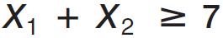
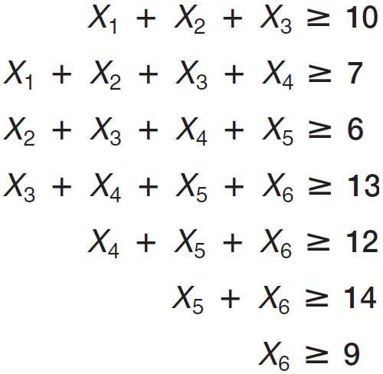
Solving Models with General Integer Variables
Example 15.3 (continued) Brewer Services
X_{i} = integer number of part-time workers that start on the i^{th} 4-hour (i =1 for 8 a.m., …, i = 6 for 1 p.m)

Slide 16
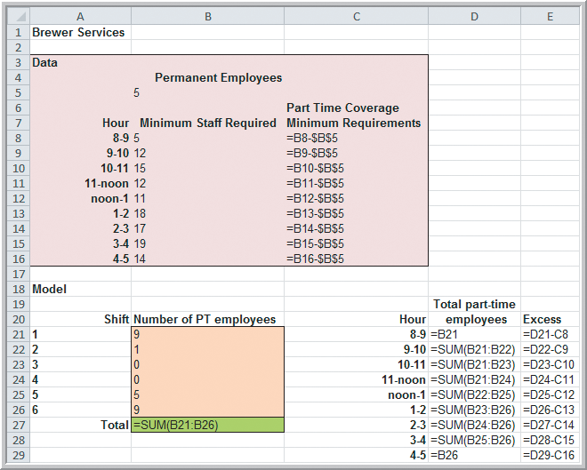
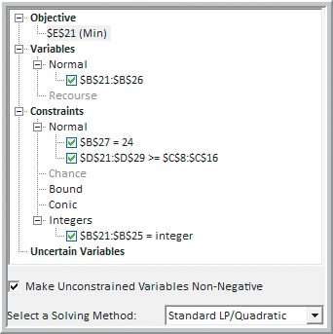
Solving Models with General Integer Variables
Example 15.3 (continued) Brewer Services
Figure 15.7b
Figure 15.8

Slide 17
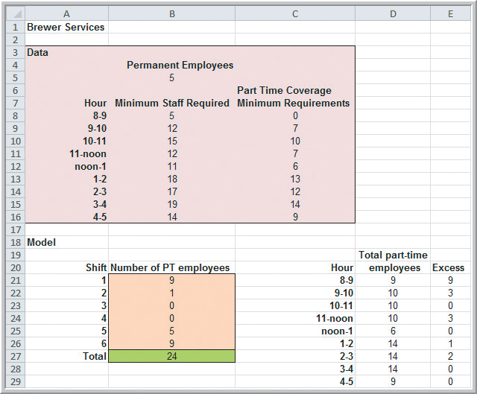
Solving Models with General Integer Variables
Example 15.3 (continued) Brewer Services
Optimal number of workers to hire for shifts starting at:
8 a.m. - 9 workers
9 a.m. - 1 worker
12 p.m. - 5 workers
1 p.m. - 9 workers
Figure 15.7a

Slide 18
Solving Models with General Integer Variables
Example 15.4 Finding Alternative Optimal Solutions for Brewer Services Model
Most scheduling problems have multiple optimal solutions.
An easy way to find an alternative optimal solution is to define an additional constraint.
Add a constraint with the objective function equal to the optimal solution value:

Slide 19
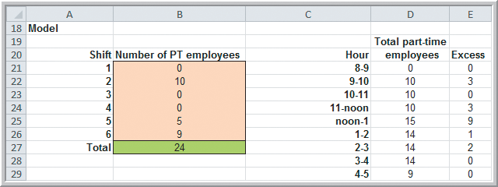
Solving Models with General Integer Variables
Example 15.4 (continued) Finding Alternative Optimal Solutions for Brewer Services Model
Solution with the added constraint
Change in optimal number of workers:
8 a.m. –9 workers
9 a.m. +9 workers
Figure 15.10

Slide 20
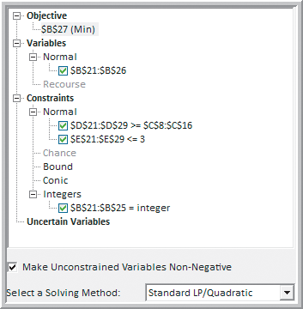
Solving Models with General Integer Variables
Example 15.4 (continued) Finding Alternative Optimal Solutions for Brewer Services Model
A better approach to finding alternate optimal is to define additional constraints that restrict excess employees to a maximum number, say k = 3.
Figure 15.11

Slide 21
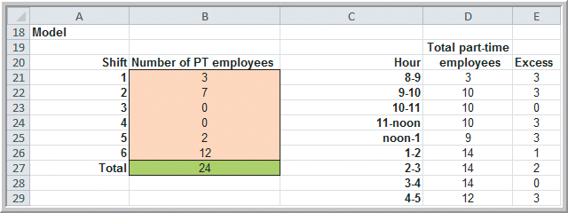
Solving Models with General Integer Variables
Example 15.4 (continued) Finding Alternative Optimal Solutions for Brewer Services Model
Solution with the added k = 3 constraints
Change in optimal number of workers:
8 a.m. –6 workers
9 a.m. +6 workers
12 p.m. –3 workers
1 p.m. +3 workers
Figure 15.12

Slide 22
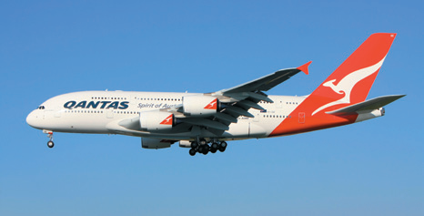
Solving Models with General Integer Variables
Analytics in Practice: Sales Staffing at Quantas
Quantas Airways uses an integer programming model to determine the least-cost staff size in its telephone reservation system.
The model uses demand forecasts to optimize staff size over time.
Outputs from the model include number of staff per shift, start and finish times of each shift, break schedules, and total staff needed for each day.

Slide 23
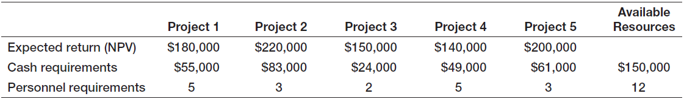
Integer Optimization Models with Binary Variables
Example 15.5 Hahn Engineering
Five potential projects are being considered.
Cash and personnel requirements do not allow selection of all 5 projects.
The objective is to determine which projects to select in order to maximize expected return.
Define X_{i} as binary: X_{i} = 1 if project i is selected
X_{i} = 0 if project i not selected
Table 15.1

Slide 24
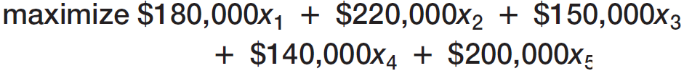
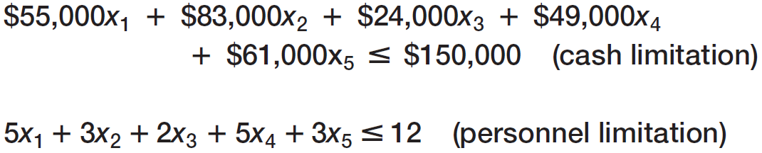
Integer Optimization Models with Binary Variables
Example 15.5 (continued) Hahn Engineering
Table 15.1

Slide 25
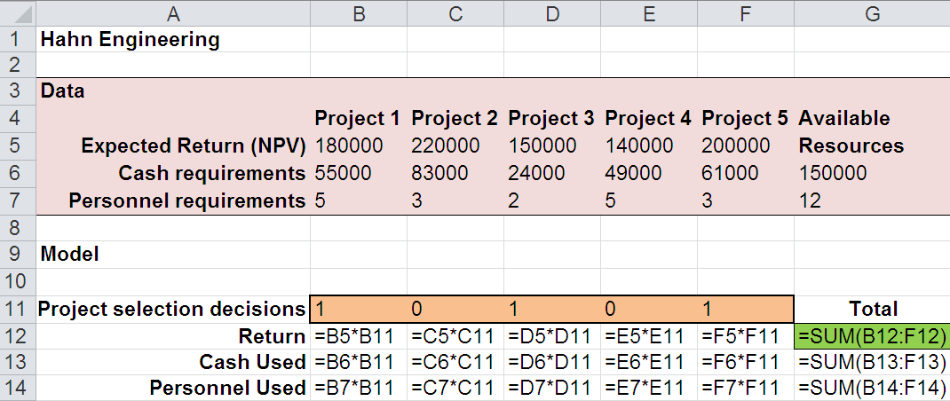
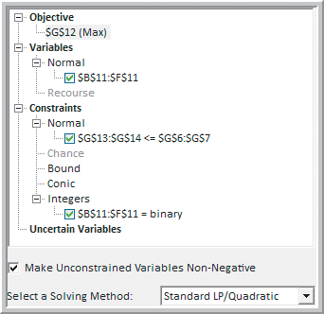
Integer Optimization Models with Binary Variables
Example 15.5 (continued) Hahn Engineering
Specify the decision variable cells as binary
From Figure 15.13
Figure 15.14

Slide 26
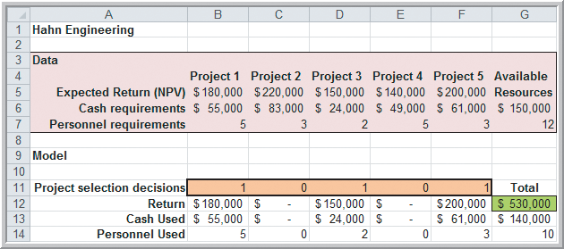
Integer Optimization Models with Binary Variables
Example 15.5 (continued) Hahn Engineering
Optimal return = $530,000
Select projects 1, 3, and 5.
Figure 15.13

Slide 27
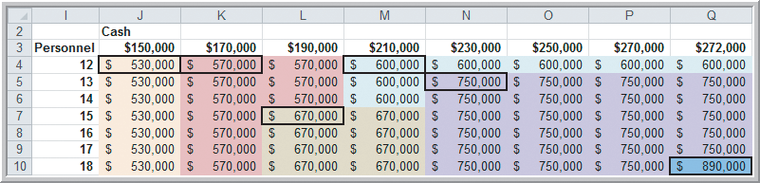
Integer Optimization Models with Binary Variables
Example 15.5 (continued) Hahn Engineering
Sensitivity analysis for integer optimization requires re-solving the problem.
The heat map below shows the impact of various levels of available resources (cash and personnel) on the expected return.
Figure 15.15

Slide 28
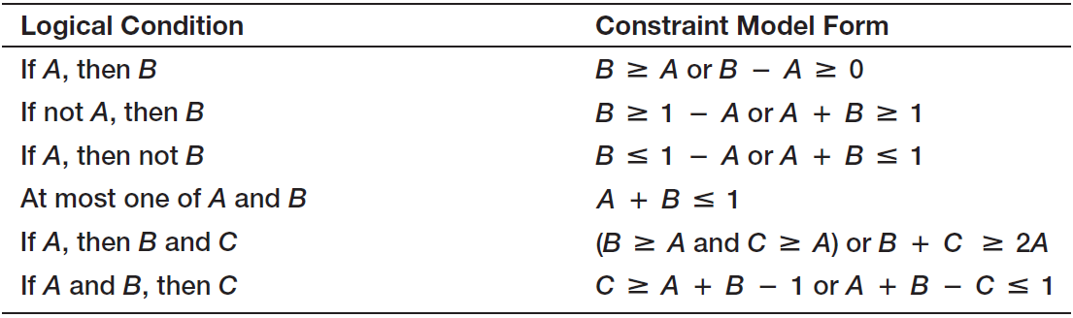
Integer Optimization Models with Binary Variables
Using Binary Variables to Model Logical Constraints
Linear optimization models do not allow logical constraints.
However, binary variables (A and B) can be used to linearly model logical constraints of the form:
Table 15.2
Table 15.2

Slide 29
Integer Optimization Models with Binary Variables
Example 15.6 Adding Logical Constraints into the Project-Selection Model (Hahn Engineering)
Suppose project managers want to ensure that:
If project 1 is selected, then project 4 is also selected (if A, then B).
Define X_{i} as binary.
→ X₄ − X₁ ≥ 0
At most one of projects 1 and 3 can be selected (at most one of A and B)
→ X₁ + X₃ ≤ 1

Slide 30
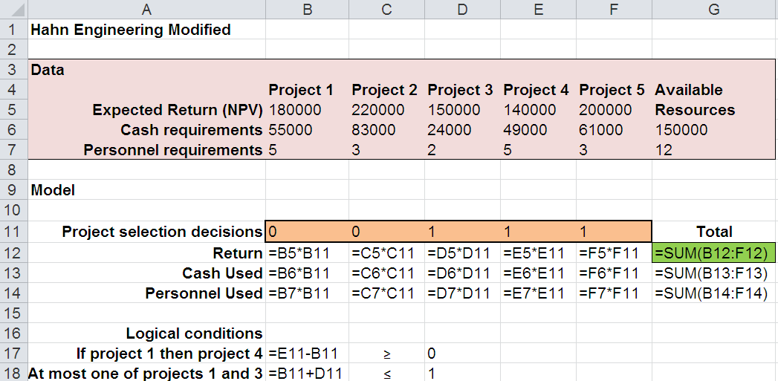
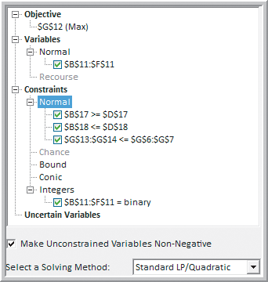
Integer Optimization Models with Binary Variables
Example 15.6 (continued) Adding Logical Constraints into the Project-Selection Model
From Figure 15.16
Figure 15.17

Slide 31
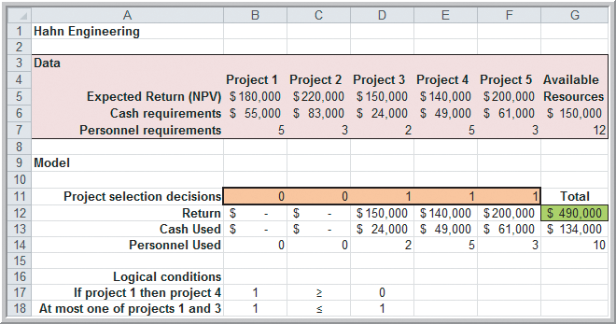
Integer Optimization Models with Binary Variables
Example 15.6 (continued) Adding Logical Constraints into the Project-Selection Model
Optimal return
= $490,000
Select projects:
3, 4, and 5
Figure 15.16

Slide 32
Integer Optimization Models with Binary Variables
Example 15.7 Anderson Village Fire Department
Covering problems seek to find a subset of locations that cover a service area.
Anderson Fire Department serves 7 districts.
The village wants to determine where to locate fire stations so that response times to residents in all 7 districts is no more than 8 minutes.
Define X_{j} as binary
X_{j} = 1 if a fire station is located in district j
X_{j} = 0 if a fire station is not located in district j

Slide 33
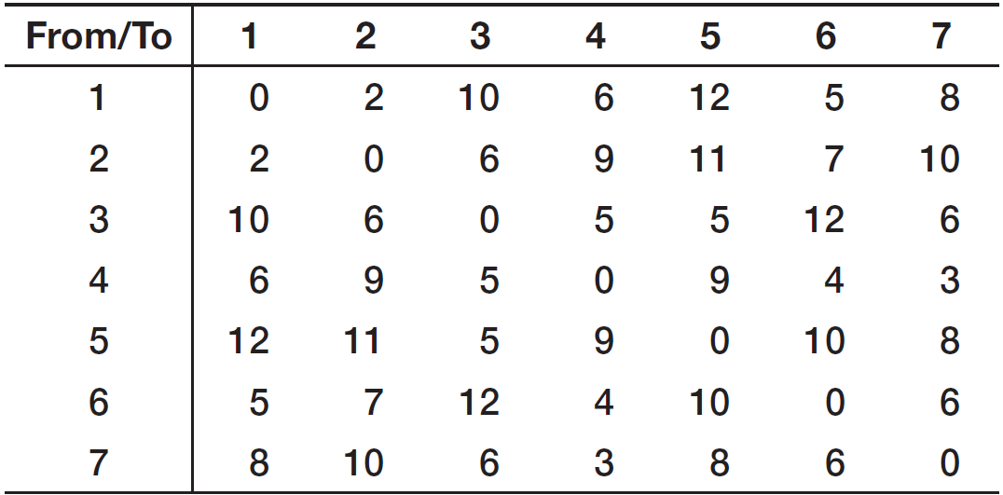
Integer Optimization Models with Binary Variables
Example 15.7 (continued)
Anderson Village Fire Department
Response times (minutes) between districts
district pairs with response times > 8

Slide 34
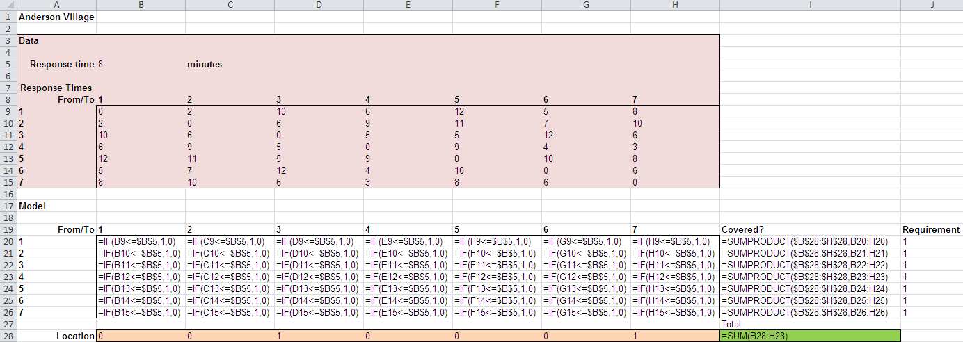
Integer Optimization Models with Binary Variables
Example 15.7 (continued)
Anderson Village Fire Department
From Figure 15.18

Slide 35
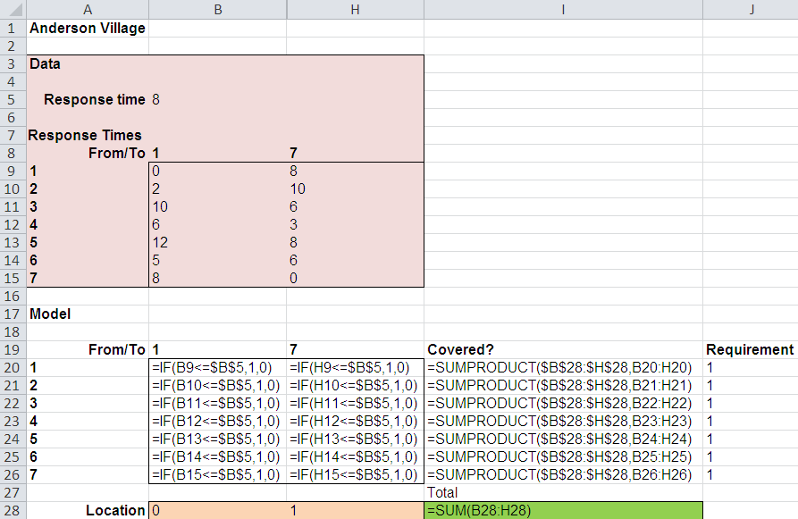
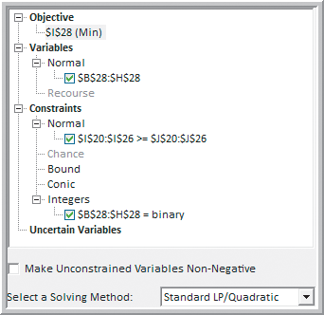
Integer Optimization Models with Binary Variables
Example 15.7 (continued)
Anderson Village Fire Department
Figure 15.19
From Figure 15.18

Slide 36
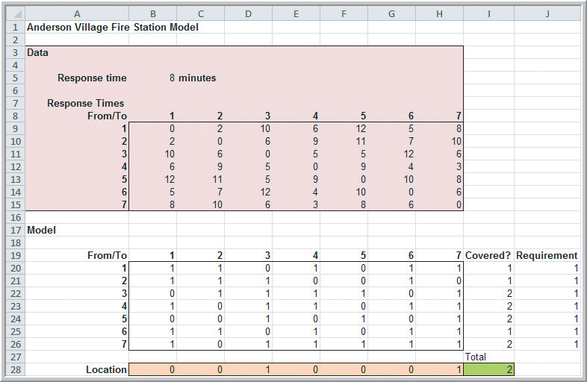
Integer Optimization Models with Binary Variables
Example 15.7 (continued)
Anderson Village Fire Department
Optimal Solution:
Cover the districts using fire stations in districts 3 and 7.
Figure 15.18

Slide 37
Integer Optimization Models with Binary Variables
Example 15.8 Parameter Analysis for Response Time (Anderson Village Fire Department)
The village’s board of trustees wants to better understand the trade-offs between response time and required number of fire stations.
Perform a Parametric Analysis using Risk Solver.
Vary response times from 5 to 10 minutes to see the effect on the number of fire stations required.

Slide 38
Integer Optimization Models with Binary Variables
Example 15.8 (continued) Parameter Analysis for Response Time
Replace cell B5 with:
=PsiOptParam(5,10)
Reports
Optimization
Parameter Analysis
Variables: B28:H28
Objective: I28
Parameters: B5
Major Axis points: 6
Figure 15.18

Slide 39
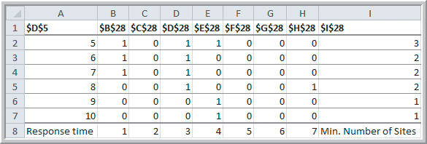
Integer Optimization Models with Binary Variables
Example 15.8 (continued) Parameter Analysis for Response Time
District Locations
1 2 3 4 5 6 7 Total Stations
Response
Times
(5-10 min.)
Figure 15.20
A response time of 5 minutes requires 3 fire stations.
A response time of 9-10 minutes requires 1 fire station.

Slide 40
Integer Optimization Models with Binary Variables
A Customer-Assignment Model for Supply Chain Optimization
Suppose a company has numerous potential locations for distribution centers.
Distribution centers ship products to customers.
A single-sourcing policy specifies that each customer can only be supplied from one distribution center.
The problem is to determine which customers to assign to each distribution center.

Slide 41
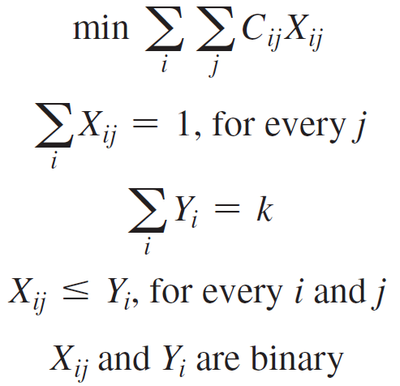
Integer Optimization Models with Binary Variables
A Customer Assignment Model for Supply Chain Optimization (continued)
X_{ij} = 1 if customer j is assigned to
distribution center i
X_{ij} = 0 if not
Y_{i} = 1 if distribution center i is
selected as a location
Y_{i} = 0 if not
C_{ij} = total cost of satisfying the
demand of customer j from
distribution center i
k = number of distribution centers
to be selected

Slide 42
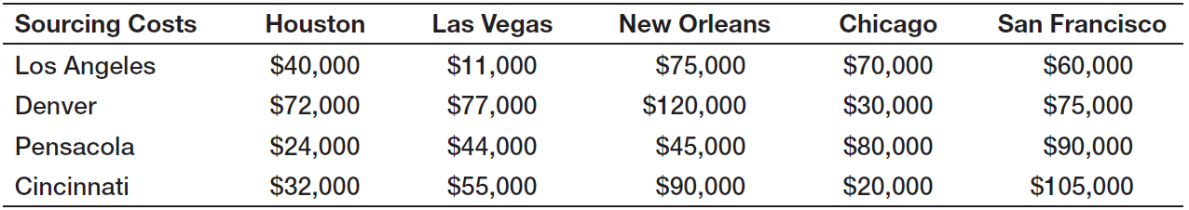
Integer Optimization Models with Binary Variables
Example 15.9 Paul & Giovanni Foods
Distributes restaurant supplies in 5 major cities.
Four possible locations for distribution centers have been identified.
P&G wants to determine the supply chain configuration that minimizes sourcing costs.

Slide 43
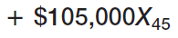
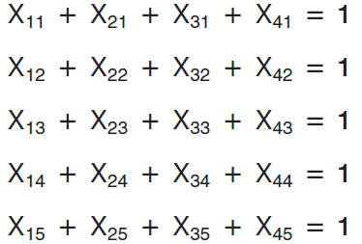
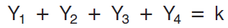
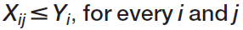
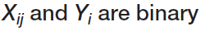
Integer Optimization Models with Binary Variables
Example 15.9 (continued) Paul & Giovanni Foods
+ …
X_{ij} = 1 if city j is assigned to
distribution center i
Y_{i} = 1 if distribution center i is
selected as a location
k = number of distribution centers
to be selected

Slide 44


Integer Optimization Models with Binary Variables
Example 15.9 (continued)
Paul & Giovanni Foods
Model with k = 2
From Figure 15.21
Figure 15.22

Slide 45

Integer Optimization Models with Binary Variables
Example 15.9 (continued) Paul & Giovanni Foods
Optimal Solution:
Total costs = $198,000
Los Angeles supplies:
Las Vegas
New Orleans
San Francisco
Cincinnati supplies:
Houston
Chicago
Figure 15.21

Slide 46

Integer Optimization Models with Binary Variables
Analytics in Practice:
Supply Chain Optimization at Proctor & Gamble
P&G uses supply chain optimization to consolidate its plants and operations.
Customers are aggregated into 150 zones and the optimization models are used to examine the effects of different distribution center locations.
After reconfiguring their supply chain using optimization models, P&G saved millions of dollars annually.

Slide 47
Mixed-Integer Optimization Models
Example 15.10
A Mixed-Integer Plant Location Model
General Appliance Corporation (GAC) currently produces refrigerators at 2 plants.
GAC is considering adding a third plant at either Fayettesville or Chico.
They ship refrigerators to 5 distribution centers.
The company now faces two decisions: which plant to build and how to best ship product from the plants to the distribution centers.

Slide 48
Mixed-Integer Optimization Models
Example 15.10 (continued)
A Mixed-Integer Plant Location Model
The objective is to minimize the total cost of shipping between plants and distribution centers.
Define16 shipping decision variables as: X_{ij} = amount shipped from plant i to distribution center j
Define 2 binary decision variables as:
Y_{i} = 1 if plant i is built and Y_{i} = 0 if not built.
This is a mixed-integer optimization because Y is restricted to integer values but X is not.

Slide 49

Mixed-Integer Optimization Models
Example 15.10 (continued)
A Mixed-Integer Plant Location Model
Costs to ship from plant i to distribution center j
Table 15.3
Build only one of these plants.

Slide 50






Mixed-Integer Optimization Models
Example 15.10 (continued)
A Mixed-Integer Plant Location Model

Slide 51


Mixed-Integer Optimization Models
Example 15.10 (continued)
A Mixed-Integer Plant Location Model
Figure 15.24
Figure 15.23b

Slide 52

Mixed-Integer Optimization Models
Example 15.10 (continued)
A Mixed-Integer Plant Location Model
aa
Optimal Solution:
Total shipping costs = $34,101
Chico plant supplies Phoenix.
Fayetteville plant is not built.
Figure 15.23a

Slide 53
Mixed-Integer Optimization Models
Example 15.11 Incorporating Fixed Costs into the K&L Designs Model (Example 14.8)
K&L Designs makes hand-painted jewelry boxes.
Forecasted sales are 150 in autumn, 400 in winter, and 50 in spring.
Unpainted boxes cost $20 and each box takes 2 hours to complete.
Holding cost per item = 6%(20) = $1.20/quarter
$/hour labor rates are 5.5, 7, and 6.25 during autumn, winter, and spring, respectively.

Slide 54
Mixed-Integer Optimization Models
Example 15.11 (continued) Incorporating Fixed Costs into the K&L Designs Model
Suppose K&L must rent some equipment costing $65 per 3-month production season.
K&L wants to incorporate this fixed cost into their multiperiod production-inventory planning model.
Define 3 binary decision variables for each season as:
Y_{i} = 1 if production occurs during season i
Y_{i} = 0 if not

Slide 55

Mixed-Integer Optimization Models
Example 15.11 (continued) Incorporating Fixed Costs into the K&L Designs Model
P_{i} = amount to produce in season i
I_{j} = inventory at the end of season j
Y_{A} = 1 if P_{A} > 0
Y_{w} = 1 if P_{w} > 0
Y_{s} = 1 if P_{s} > 0
Figure 14.16

Slide 56



Mixed-Integer Optimization Models
Example 15.11 (continued) Incorporating Fixed Costs into the K&L Designs Model
$65 is the fixed cost if any production takes place in a season.
600 is the maximum number of units produced in a season.

Slide 57


Mixed-Integer Optimization Models
Example 15.11 (continued) Incorporating Fixed Costs into the K&L Designs Model
Figure 15.25b
Figure 15.26

Slide 58

Mixed-Integer Optimization Models
Example 15.11 (continued) Incorporating Fixed Costs into the K&L Designs Model
Optimal solution:
600 units in autumn
0 units in winter
0 units in spring
Rent the equipment only in autumn.
P_{A} = 600
I_{A} = 450
I_{W} = 50
Y_{A} = 1
Figure 15.25a

Slide 59
Chapter 15 - Key Terms
Binary variable
General integer variables
Heat map
Integer linear optimization model (integer program)
Linear program (LP) relaxation
Mixed-integer linear optimization model

Slide 60
Case Study Performance Lawn Equipment (15)
Recall that PLE produces lawnmowers and a medium size diesel power lawn tractor.
PLE is considering adding additional plants for production of it popular lawn tractor.
The capacities of the proposed plants and the fixed construction costs have been determined.
You need to develop and solve an optimization model to identify the best location for new plants.
Write a formal report summarizing your results.

Slide 61


